Slide 1


Real-Time EV Fleet Monitoring and Predictive Analytics Solution
Presented by: Mohammed Jaffer Ali.
Mentor: Ashwini.
Program: Infosys Springboard 5.0 Internship.

Slide 2
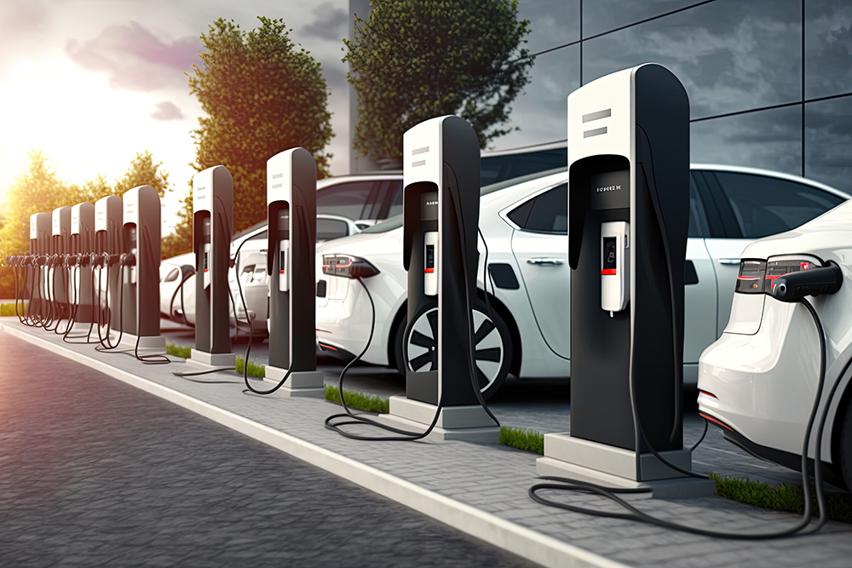
Introduction
Project Overview
In recent years, Electric Vehicles (EVs) have emerged as a critical part of the global transition towards sustainable transportation. As the adoption of EVs increases, efficient management of electric vehicle fleets becomes vital for fleet operators to ensure operational efficiency, reduce costs, and maintain a high level of performance.
This project focuses on developing a comprehensive EV Fleet Management application designed to empower fleet managers with real-time monitoring and management capabilities. The system tracks key parameters such as vehicle performance, battery health, charging status, and driver behavior, providing a holistic view of the fleet's operations. Additionally, the application incorporates advanced features like route optimization, predictive maintenance alerts, and cost analysis based on energy consumption.
With the integration of user authentication and reporting capabilities, this solution aims to enhance decision-making, streamline fleet management processes, and improve the overall efficiency of EV operations.

Slide 3

Project Overview
Objective
Key Features
To build a comprehensive application that helps fleet managers efficiently monitor and manage their electric vehicle fleet.
Real-time vehicle performance tracking Battery health and charging status monitoring Route optimization and maintenance alerts Energy consumption and cost analysis User authentication and report generation

Slide 4
Key Features
Real-Time Vehicle Monitoring
Route Optimization
Driver Behavior Analysis
Track location, speed, battery health, and charging status of all EVs in the fleet.
Suggest the most energy-efficient routes based on battery levels and charging stations.
Monitor driver behavior (speed, braking, acceleration) and its impact on energy consumption.
Predictive Maintenance
Cost Analysis
Proactively alert fleet managers when battery health degrades or when maintenance is needed.
Analyze and visualize energy consumption and operational costs for better fleet management.

Slide 5




Milestone 1 - Weeks 1-3
User Authentication
EV Registration
Secure registration with email verification and role-based access.
Allow fleet managers to add new EVs to the system.
Real-Time Monitoring
Integrated APIs to track vehicle data such as location, speed, and battery status.

Slide 6

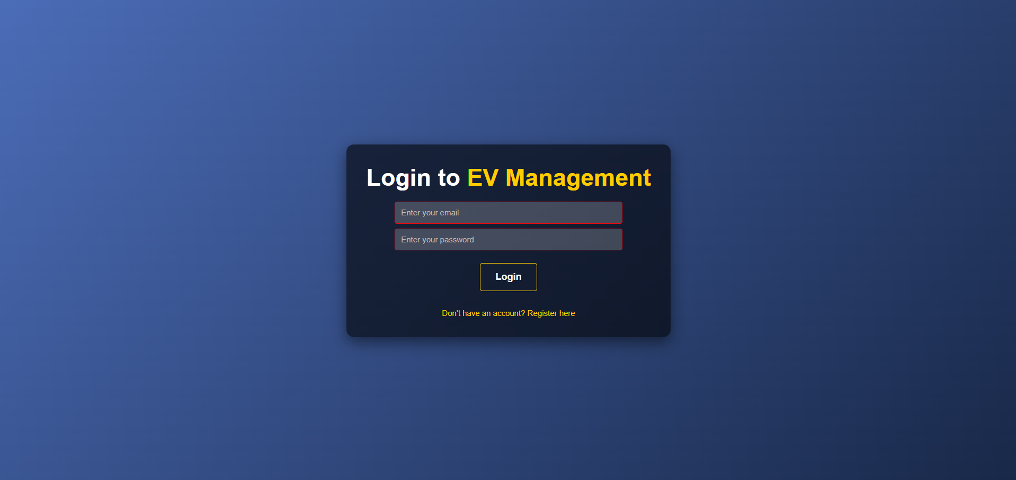
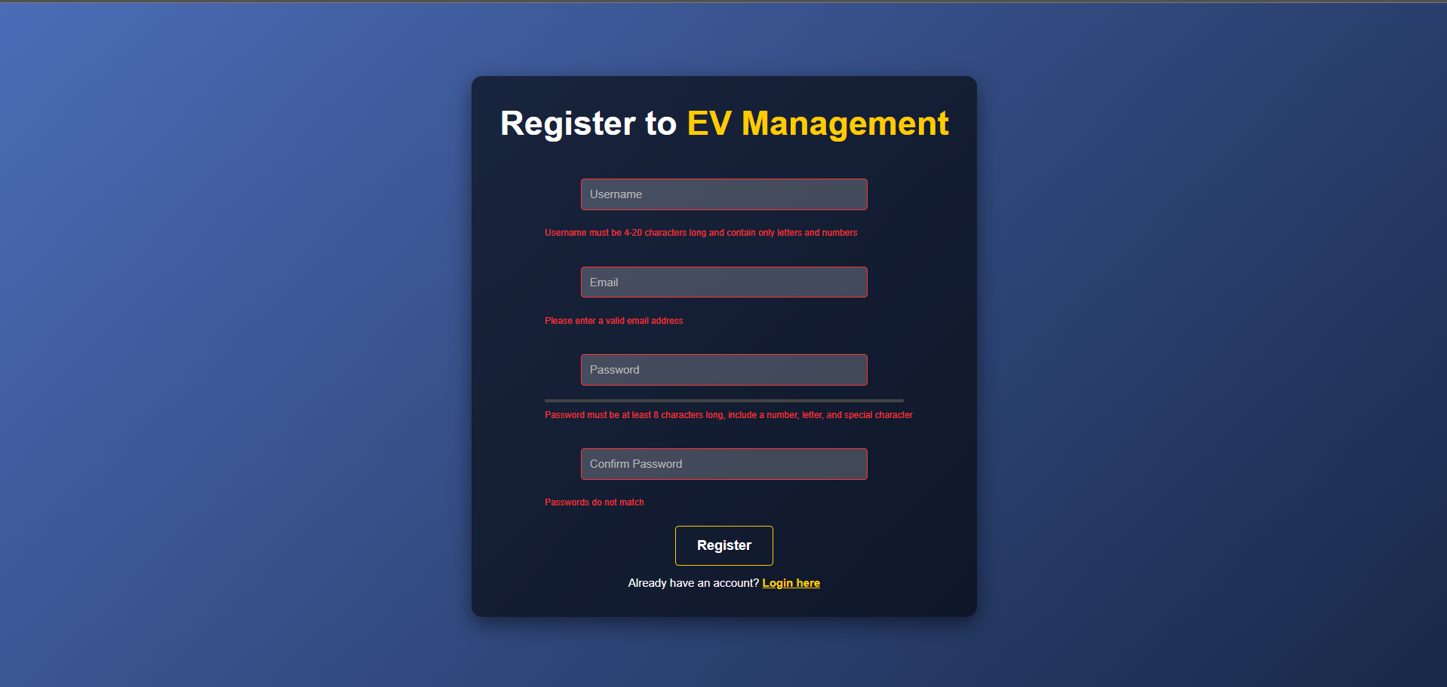
Login / Register
With Proper Form Validation

Slide 7
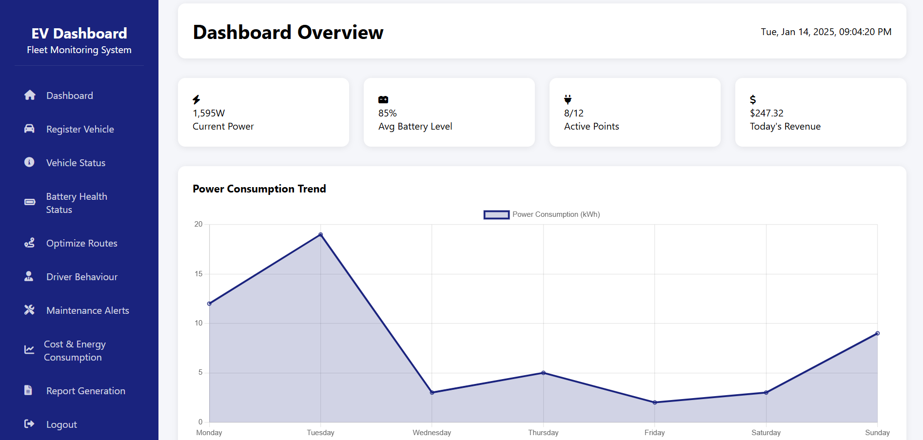
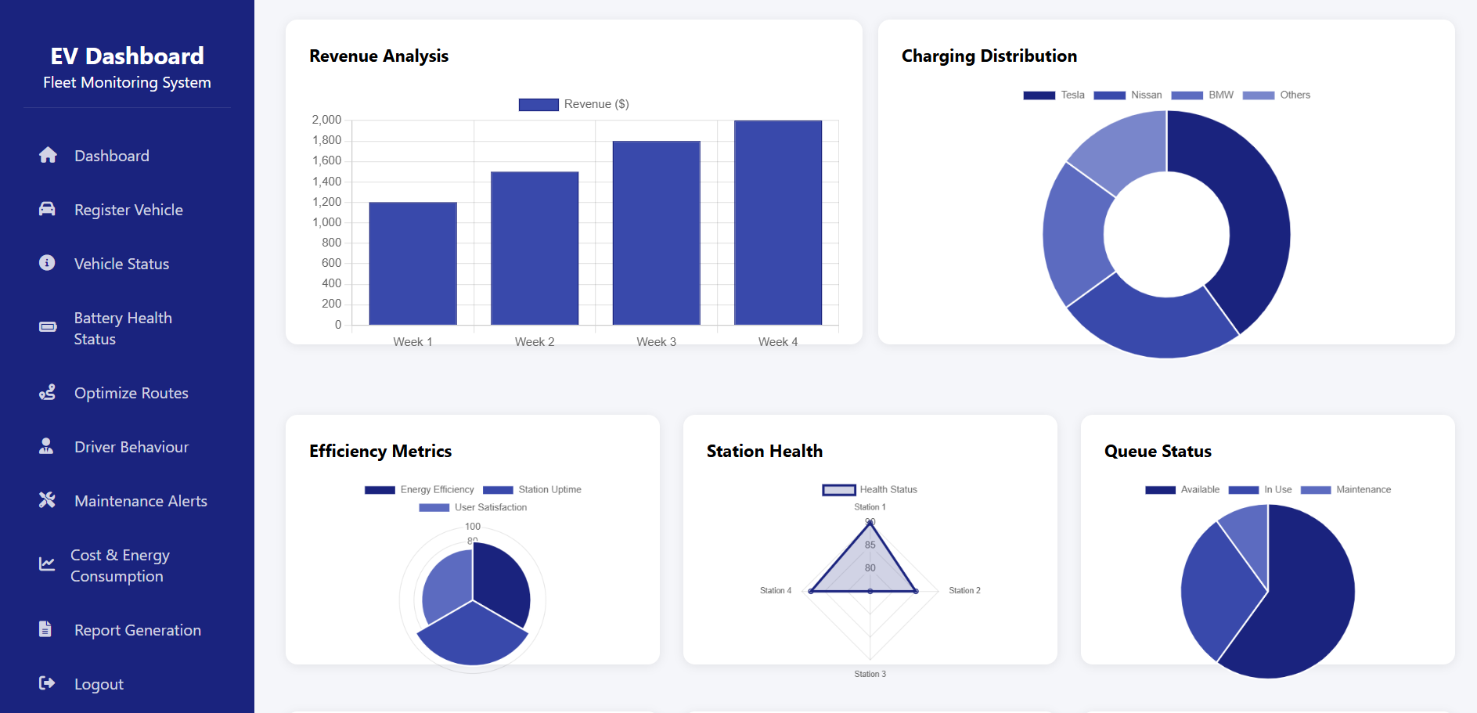
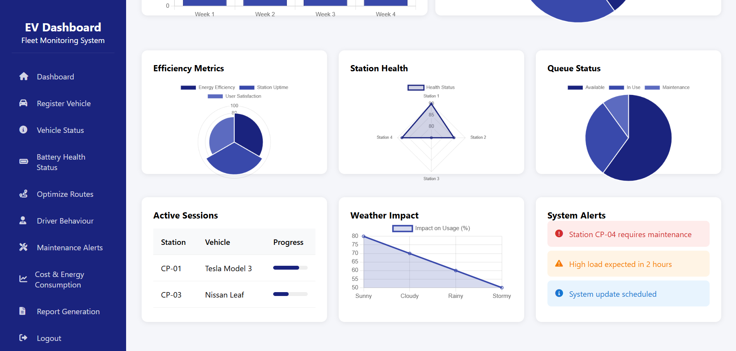
EV Dashboard Overview

Slide 8
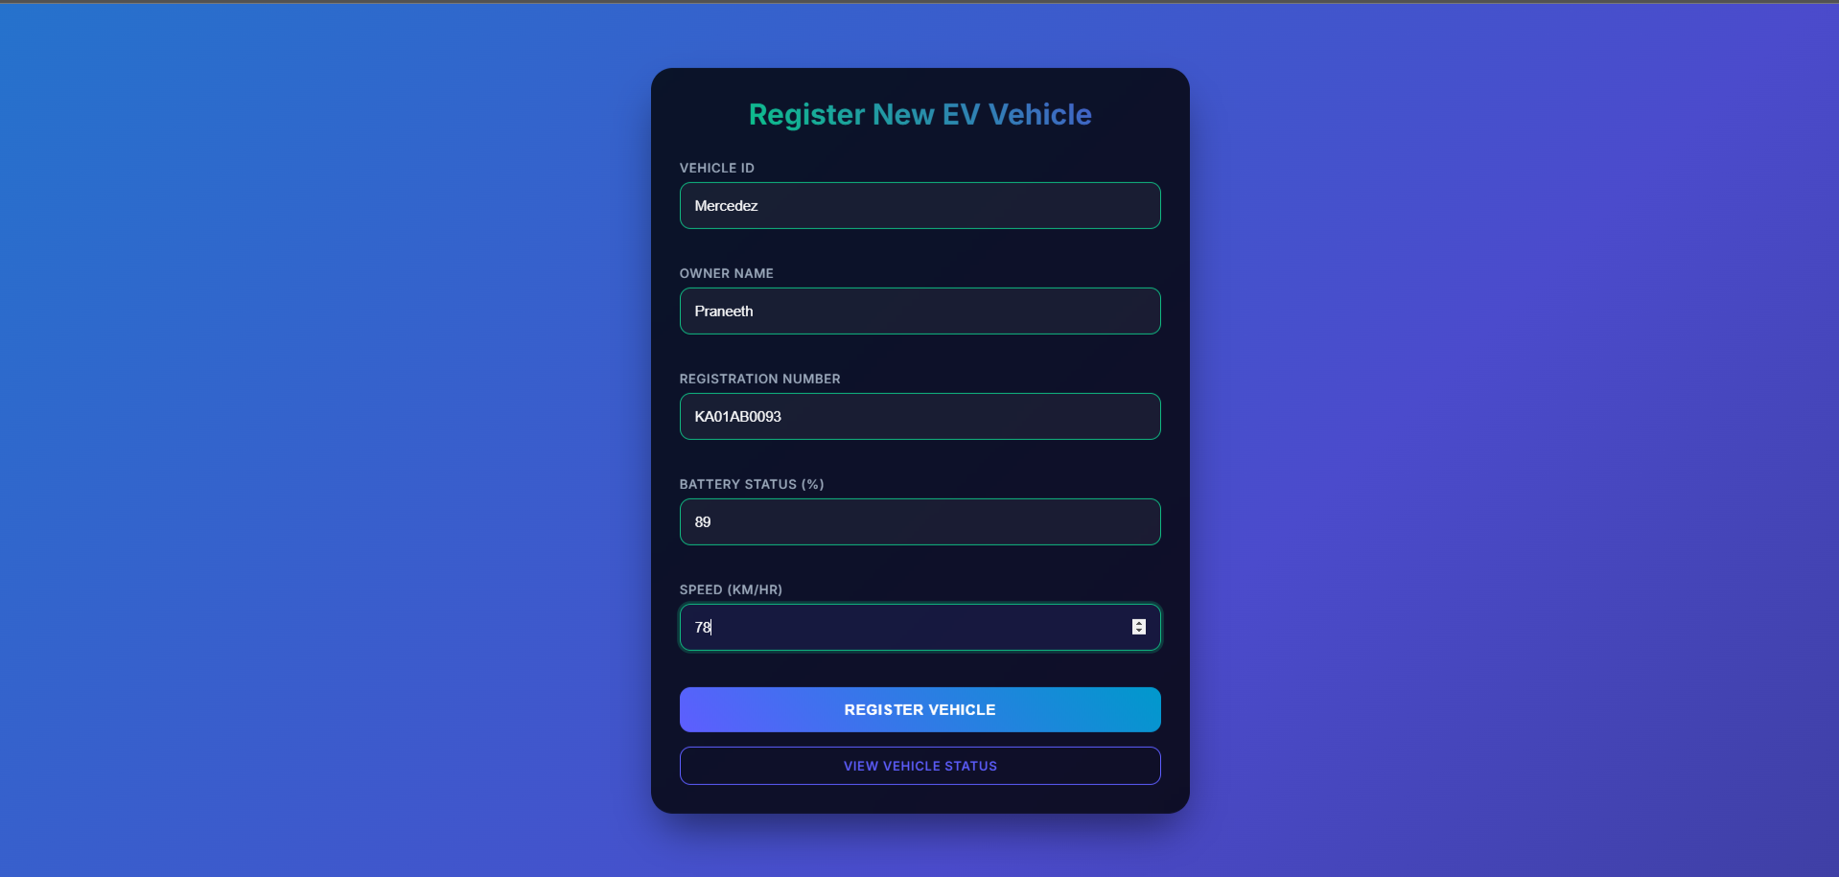
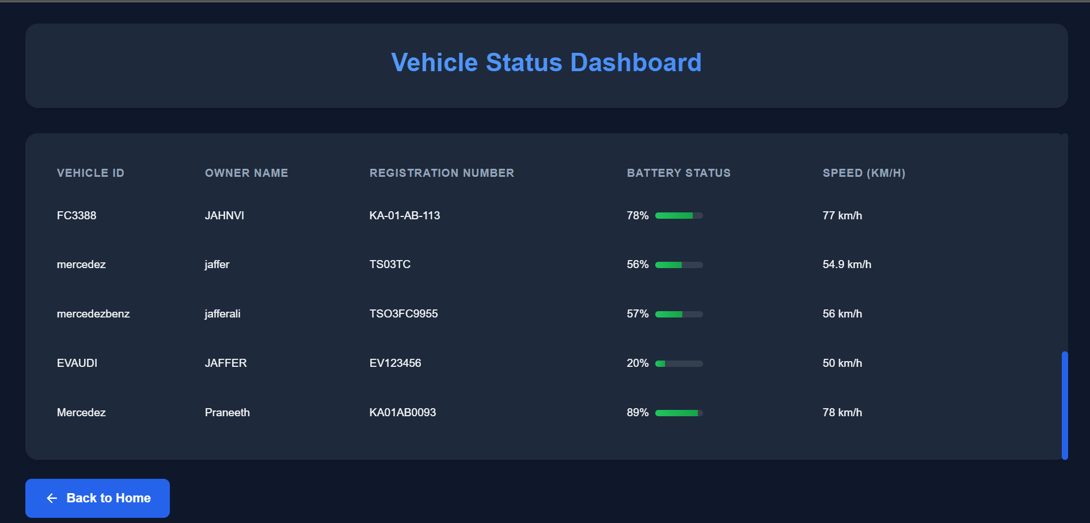
Register New EV Vehicle and
Vehicle Status Dashboard

Slide 9
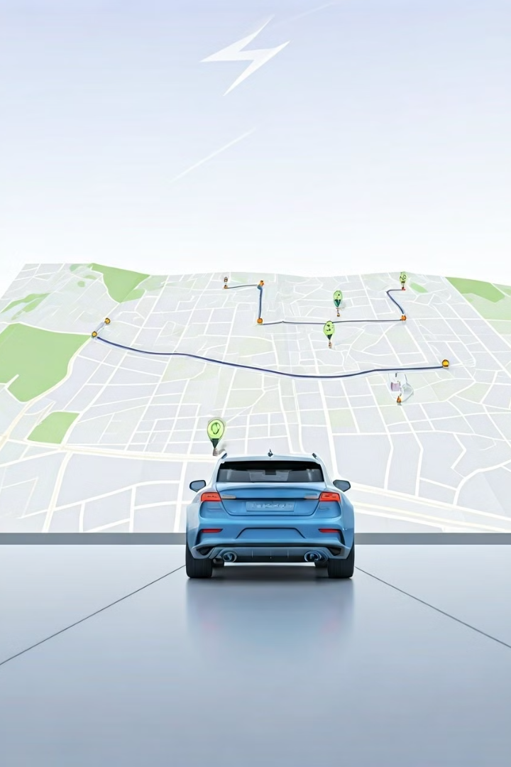
Milestone 2 - Weeks 4-5
1
Route Optimization and Battery Health Monitoring
Integrated third-party APIs to suggest the most efficient routes based on battery levels. And Implemented battery health monitoring and alert system.
2
Driver Behavior and Maintenance Analysis
Monitored driver behavior to understand and improve energy consumption patterns And Implemented a maintenance alert system based on predefined rules. .

Slide 10
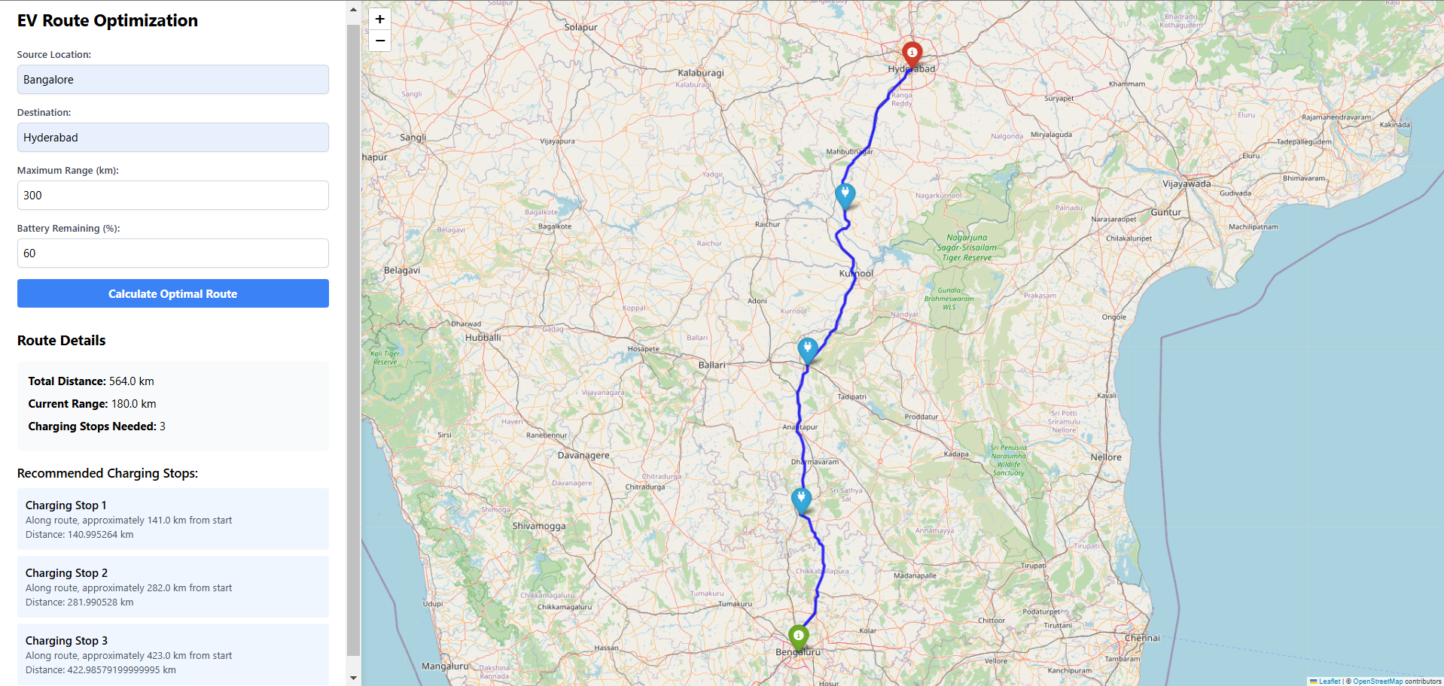
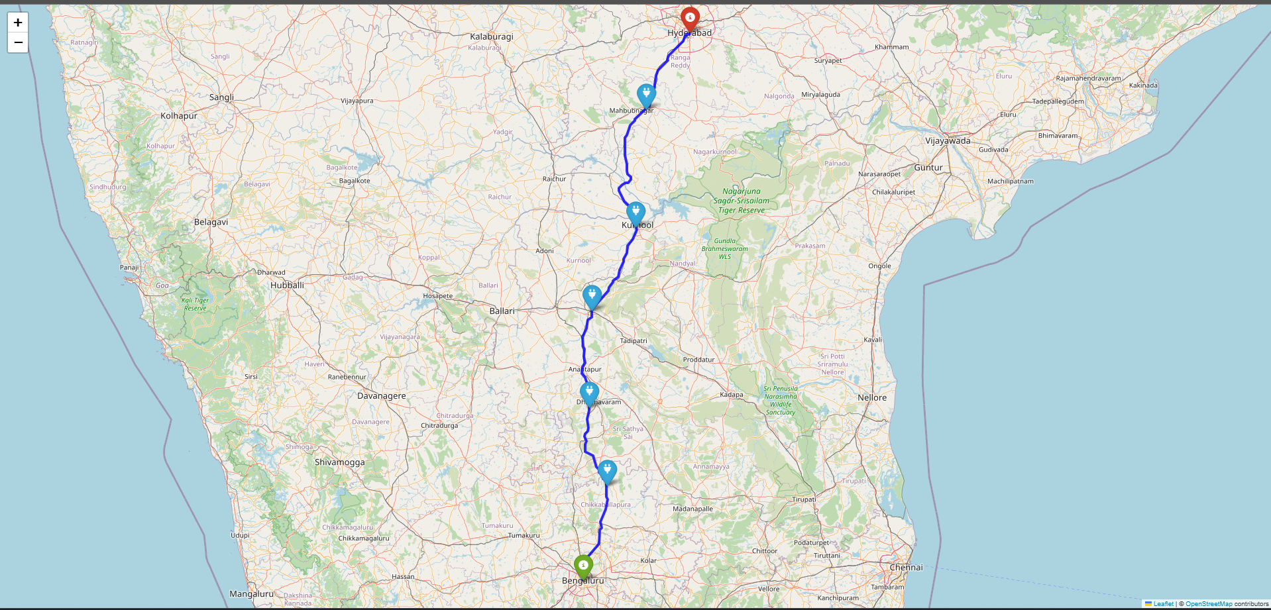
Real-Time EV Route
Optimization
GRAPHHOPPER API- For Routing and Navigation
OPEN_CHARGE_MAP API- For EV charging Stations
GEO_CODE- For Geocoding to convert co ordinated to address
Intelligent route planning with charging stops.
Real-time battery monitoring.
Dynamic route adjustments.
Charging station locator.
Map visualization with saved images to device.
Auto-calculation of required charging stops.

Slide 11
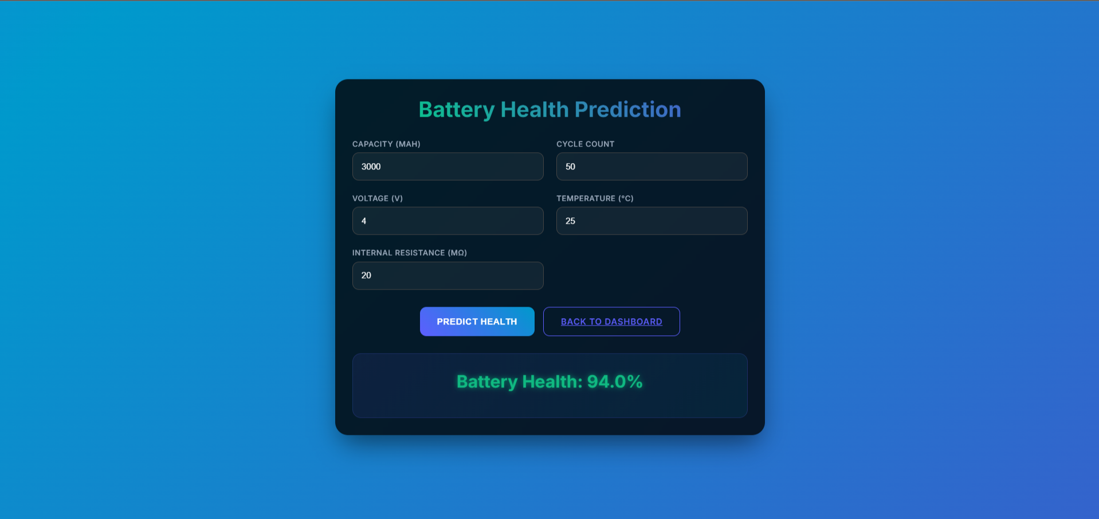
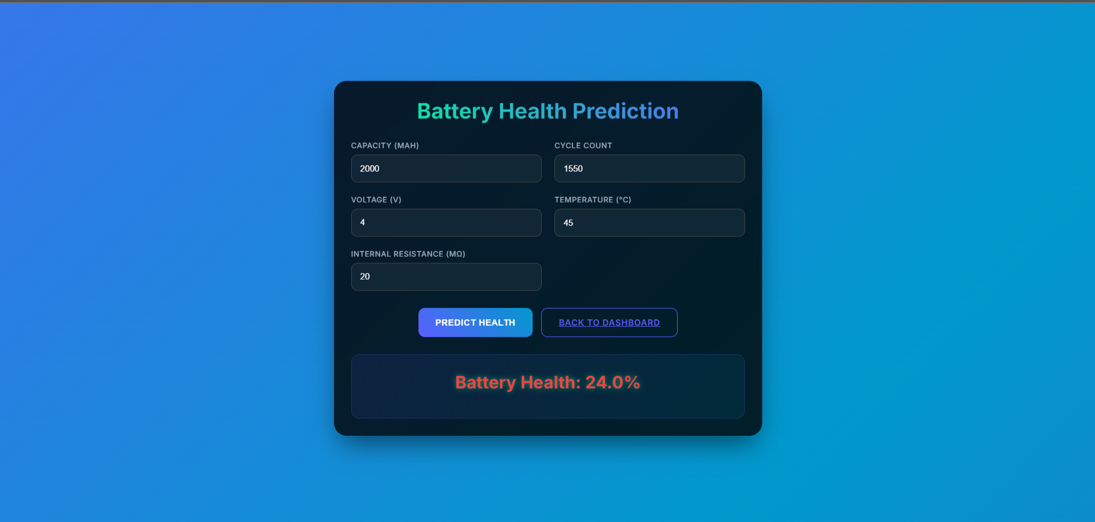
Battery Health Prediction
(Using ML Model)
Machine Learning-powered analysis using Random Forest Regressor: The battery_health_model.pkl file is used after performing Random Forest Regressor to predict Battery Health.
Why Random forest?
Because it handles non-linear relationships, can manage high-dimensional data, is resistant to overfitting, making it effective for predicting complex outcomes.

Slide 12
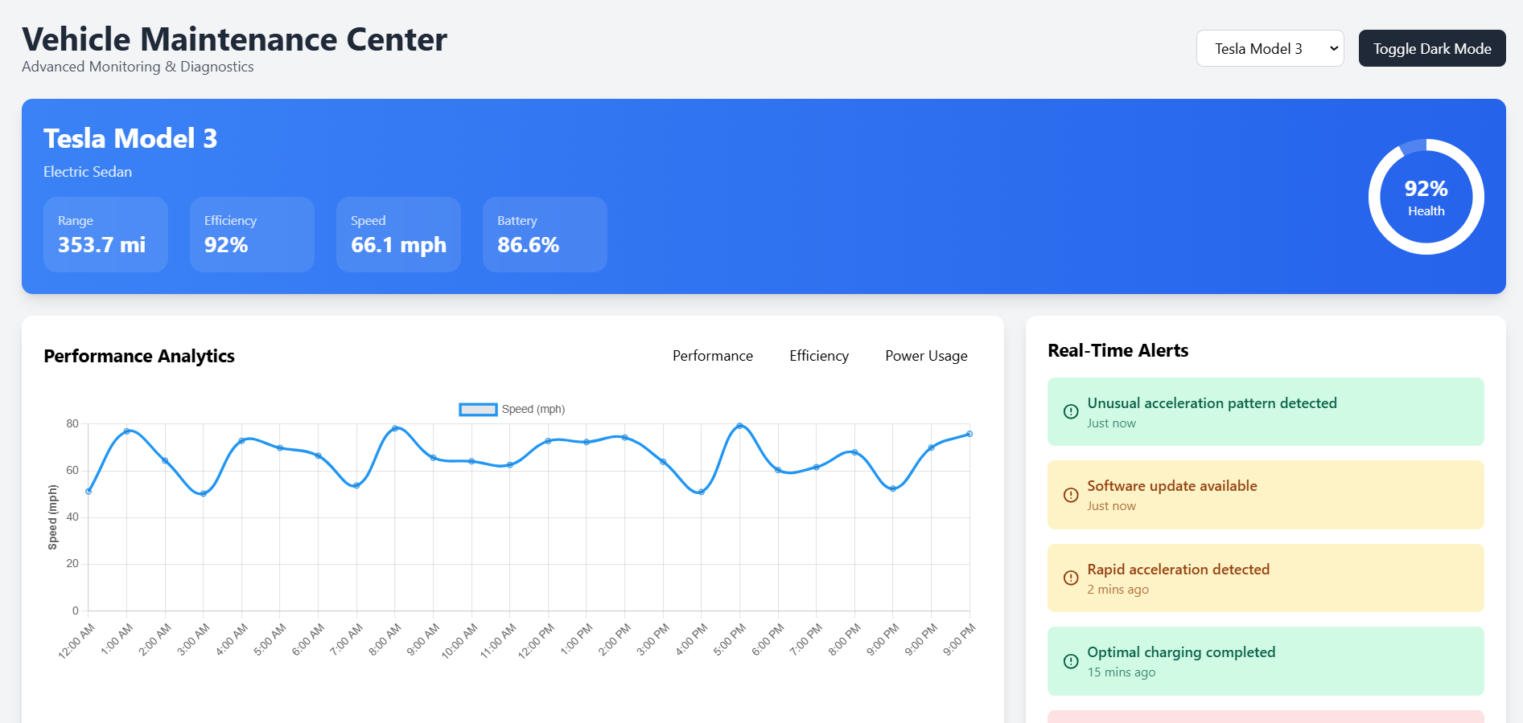
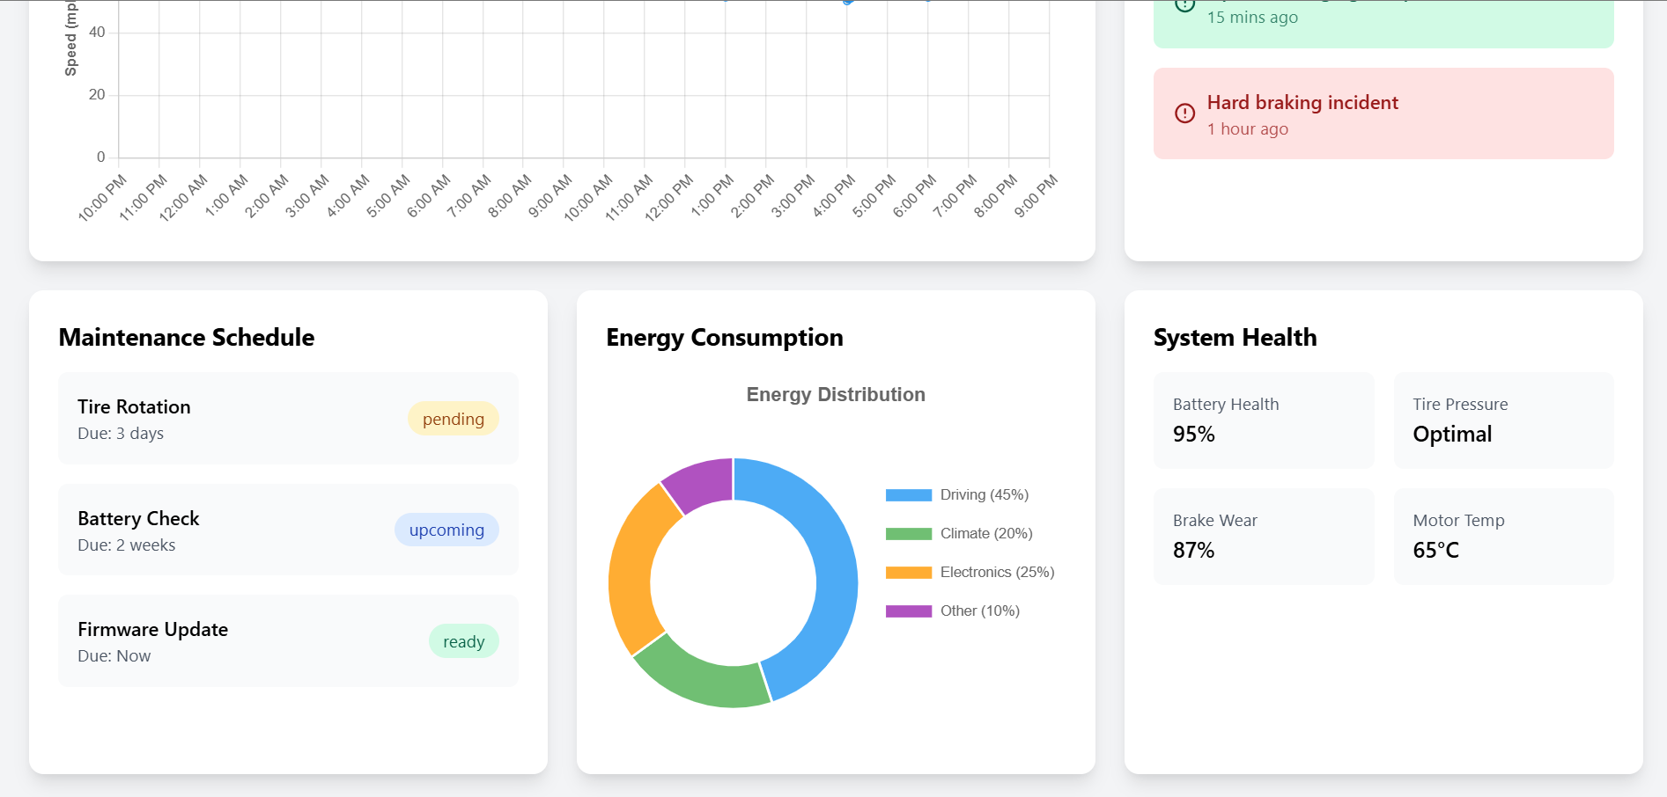
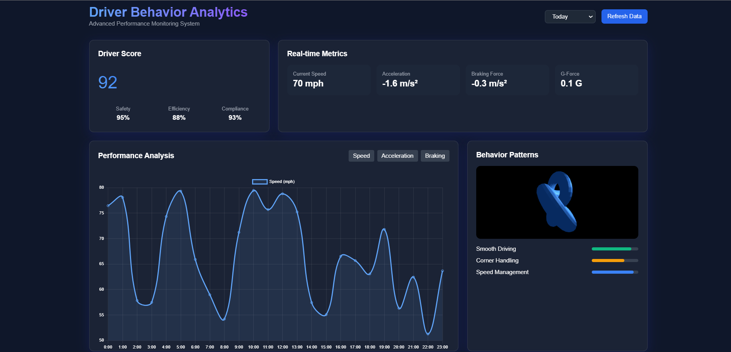
Vehicle Maintenance and
Driver Behaviour Analysis

Slide 13
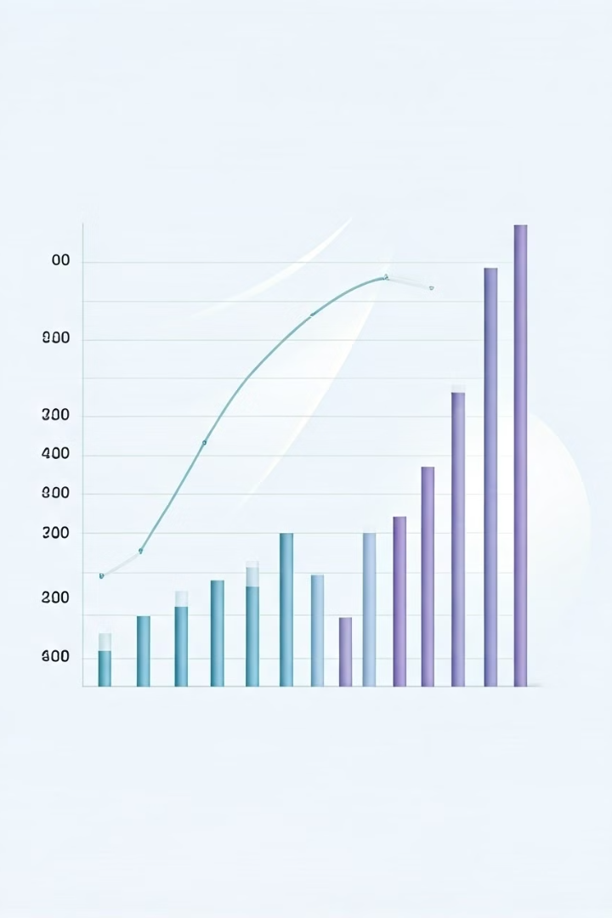

Milestone 3 - Weeks 6-7
Cost and Energy Consumption Analysis
Developed features to calculate and visualize energy consumption and operational costs, providing actionable insights for fleet managers And also Implemented interfaces for displaying cost analysis. .

Slide 14
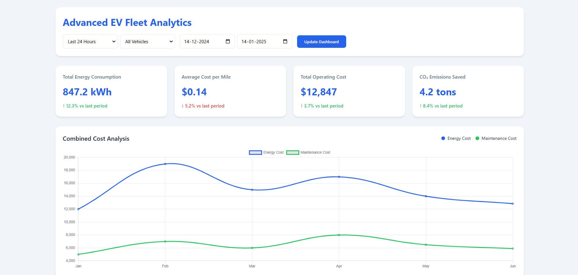
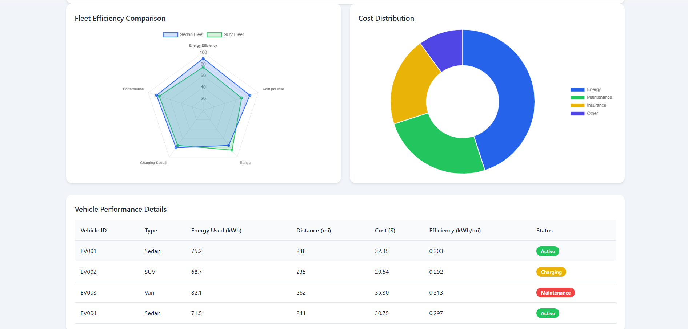
Cost and
Energy Consumption Analysis
Total Energy Consumption tracking
Cost per Mile Analysis
CO₂ Emissions Saved calculation
Fleet Efficiency Comparison

Slide 15


Milestone 4 - Weeks 8-10
Custom Report Generation
1
Enabled fleet managers to generate detailed reports on vehicle performance and energy use.
Machine Learning Model
2
Integrated a model for predictive battery health analysis to reduce downtime(battery_health_prediction.pkl).

Slide 16
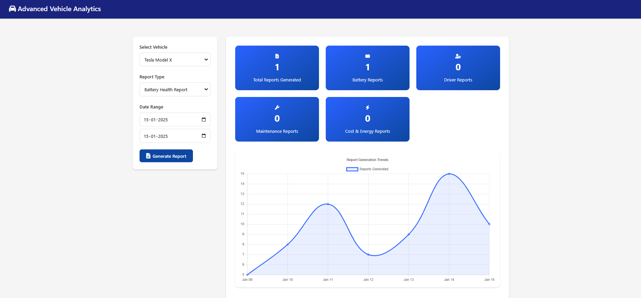
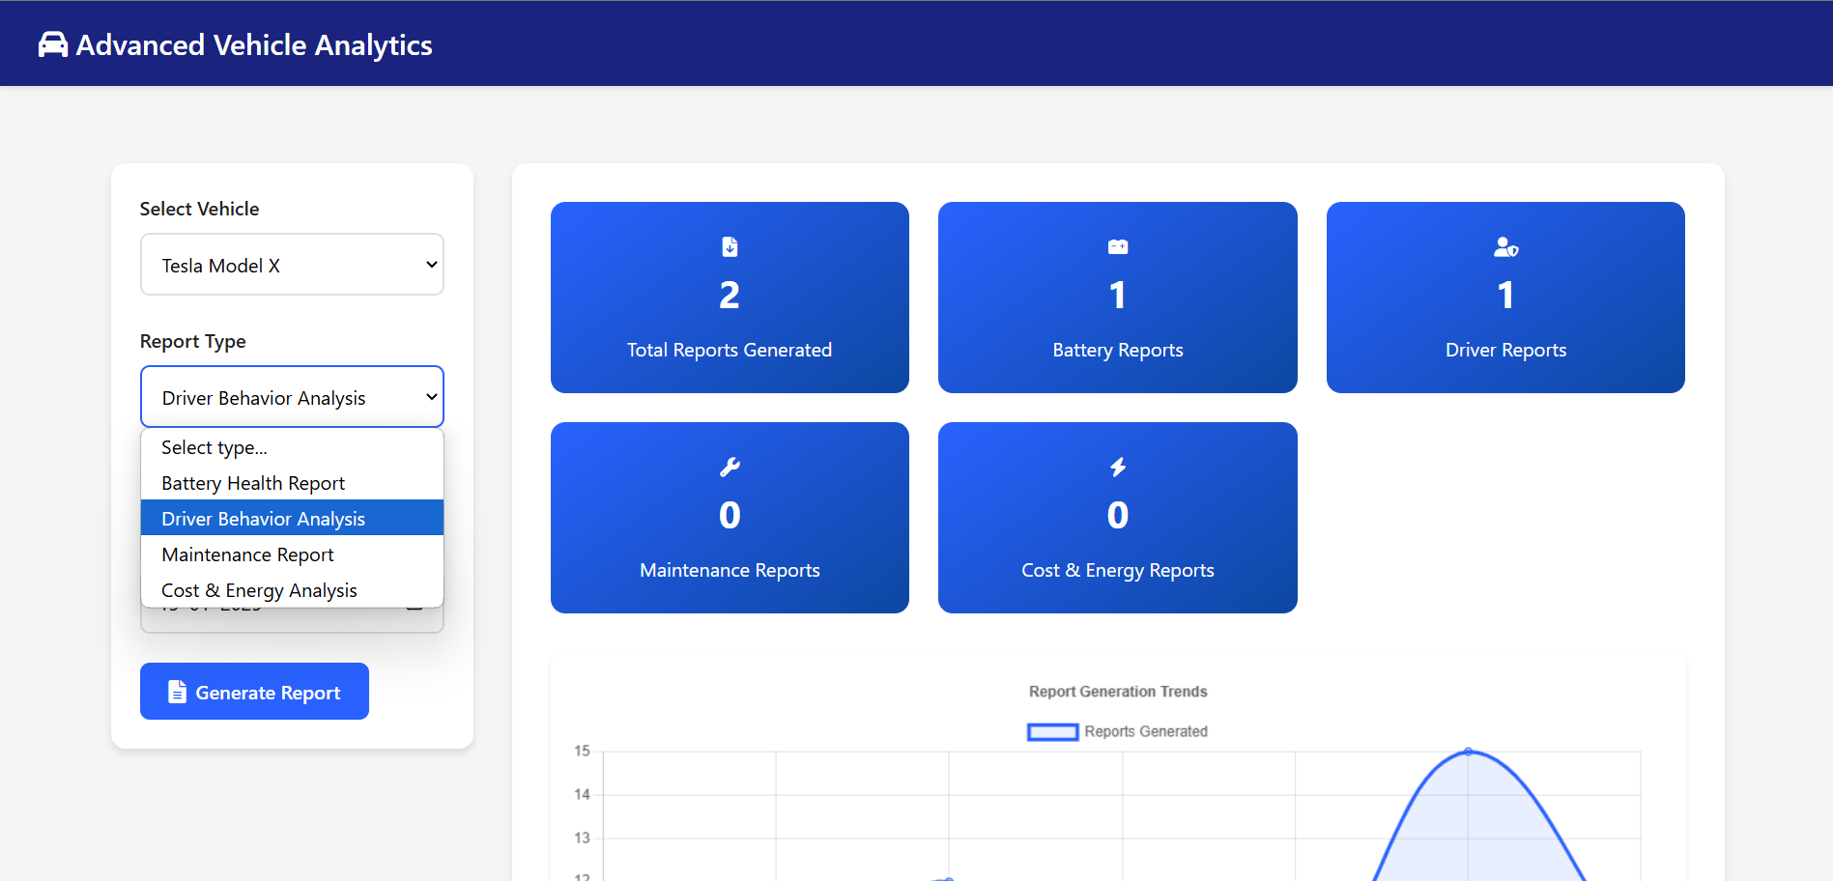
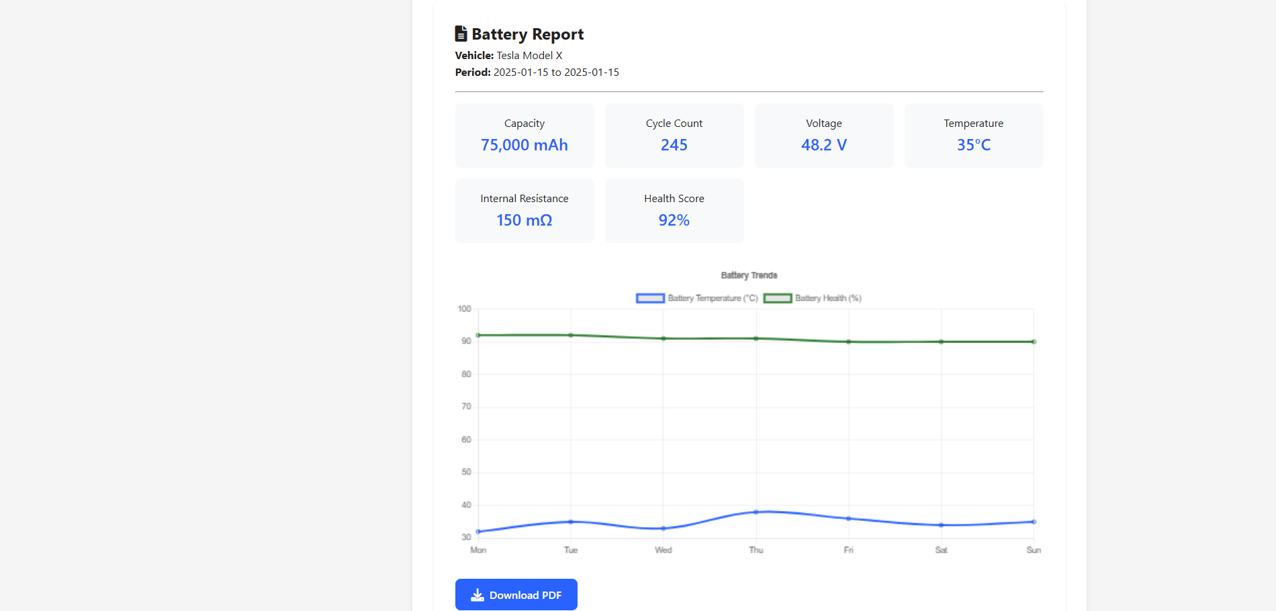
Custom Report Generation
Select Vehicle: Choose the vehicle for the report.
Report Type: Select the type of report (Battery Reports, Driver Reports, Maintenance Reports, Cost & Energy Reports).
Date Range: Select the start and end dates for the report (dd-mm-yyyy).
Generate Report: Button to generate the report based on the selected options.
Total Reports Generated: Displays the total number of reports generated.

Slide 17
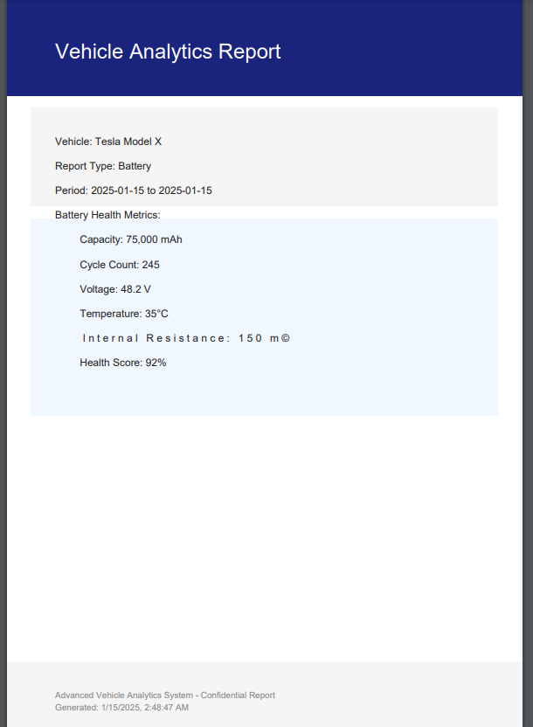
Generated Report
Sample
Save Reports as PDF:
The generated reports are saved in PDF format, which can be downloaded from the history section

Slide 18
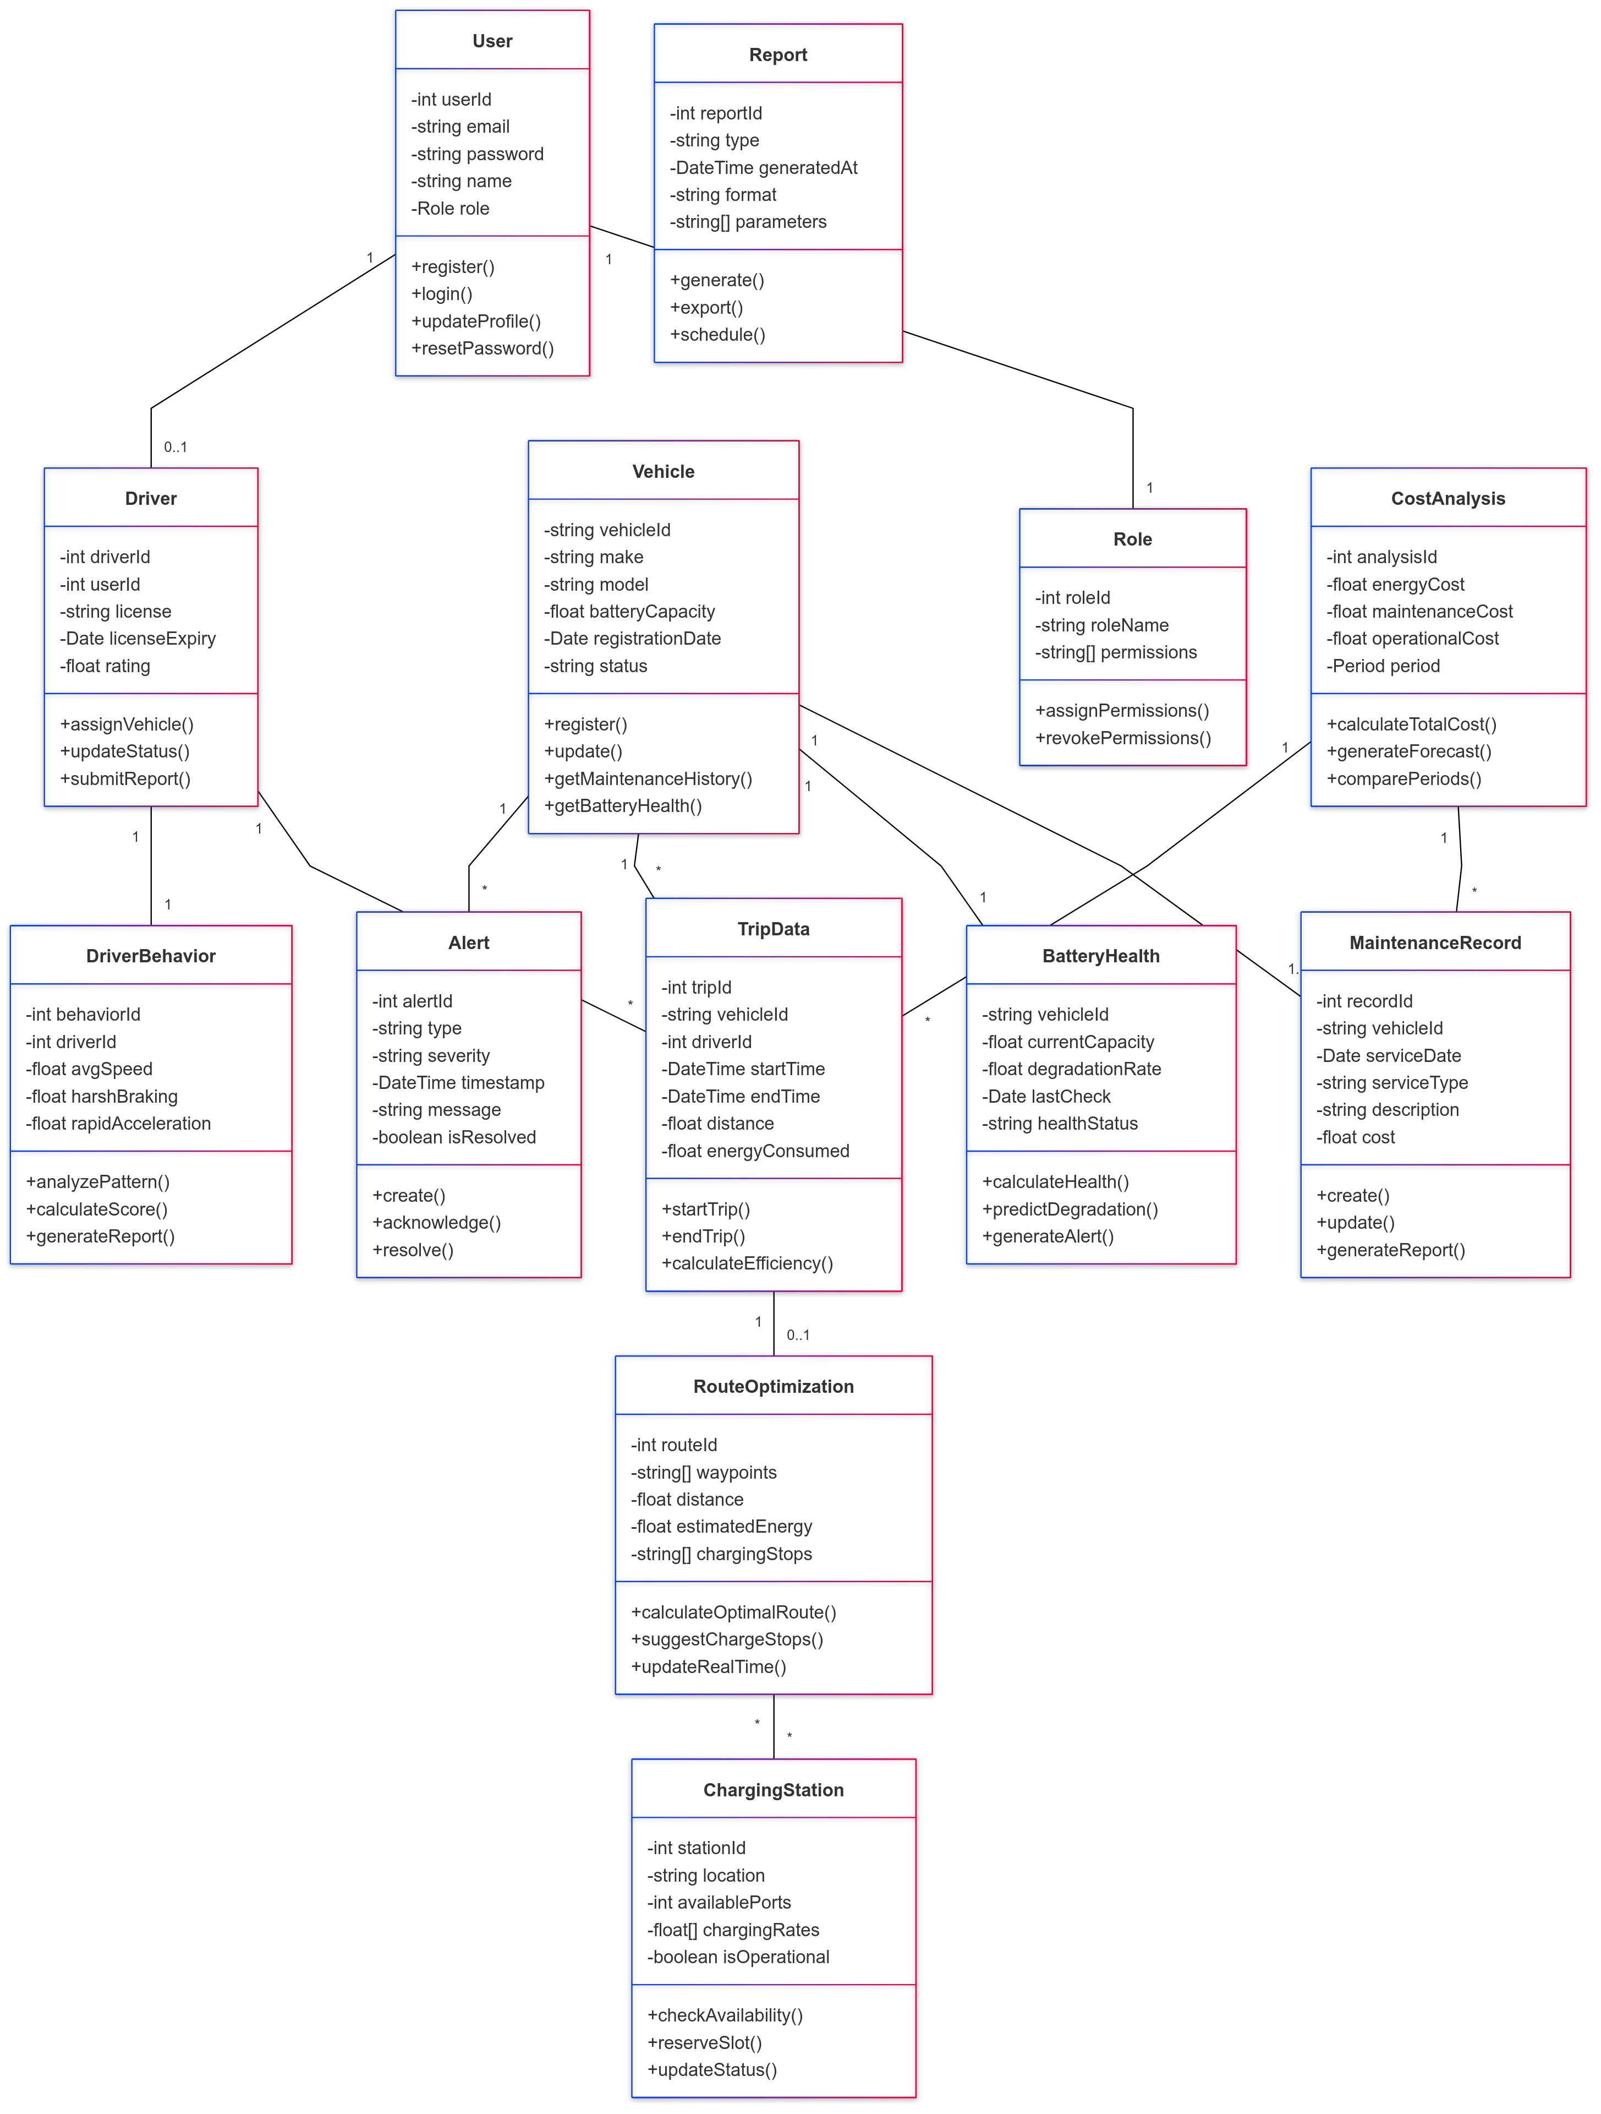
Class Diagram
The class diagram represents the structure of the EV fleet monitoring system, showcasing key classes and their relationships.
It includes classes for vehicles, drivers, maintenance schedules, route optimization, and battery health prediction.

Slide 19

Conclusion
1
2
Insights & Analytics
Efficiency Enhancement
This project provides real-time insights and predictive analytics for EV fleet management, optimizing fleet operations and reducing costs.
By integrating machine learning, we've enhanced the ability to predict maintenance needs, increasing fleet efficiency.

Slide 20


